Slide 1
Competitive Game：
The influence of obvious advertisements and the posting order on the competitiveness of SMIs.

Slide 2
Background and introduction
Huge economic benefits
SMIs
Products
Consumers
???

Slide 3
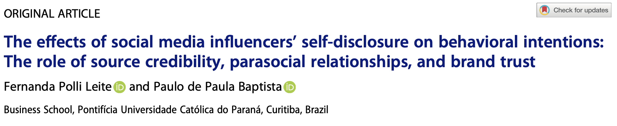
Literature Review

Slide 4
Literature Review
There exists a positive correlation between SMIs' intimate self-disclosure and the strength of quasi-social ties.
There exists a positive correlation between SMIs' credibility and consumers' willingness to purchase endorsed brands.
There exists a positive correlation between SMIs' credibility and consumers' trust in the brand.

Slide 5
Research Question
The influence of obvious advertisements and the posting order on the competitiveness of SMIs.
How does Posting with obvious advertisements affect a SMI’s competitiveness without an obvious posting order?
How does Posting with obvious advertisements affect a SMI’s competitiveness with an obvious posting order?

Slide 6
Assumptions
1. SMI accounts is highly similar
2. Specific audience preferences are not taken into consideration.
3. SMIA and SMIB have a direct and evident competitive relationship
4. All viewers simultaneously browse and compare the content of both influencers.
5. Long-term financial gains (linked to the favorability of followers) more important than short-term financial gains.

Slide 7
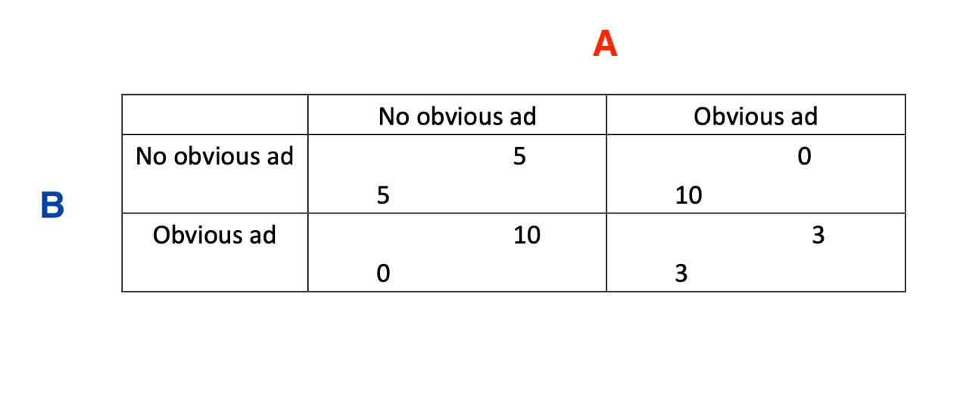
Post at the same time
Game model

Slide 8
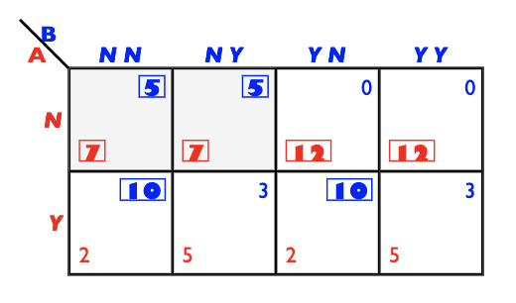
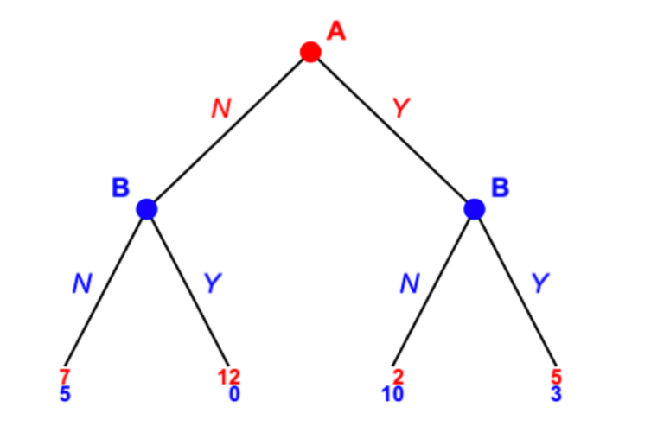
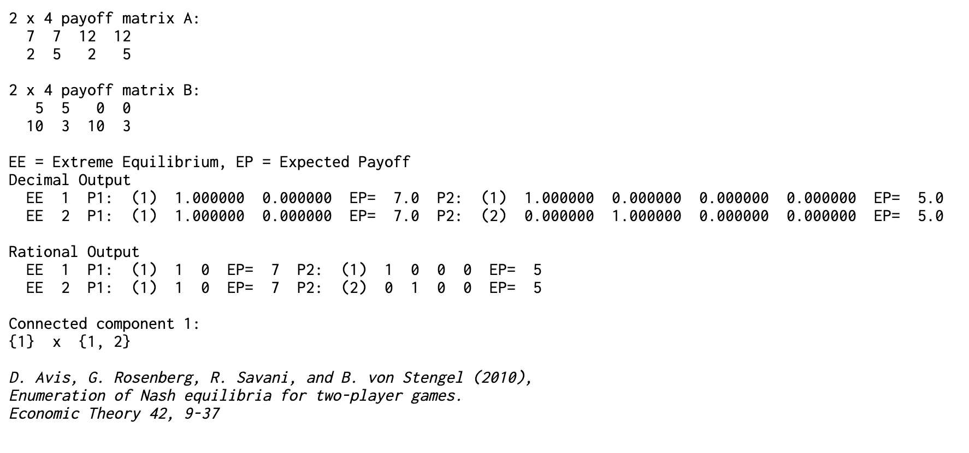
Game model
Post at different times

Slide 9
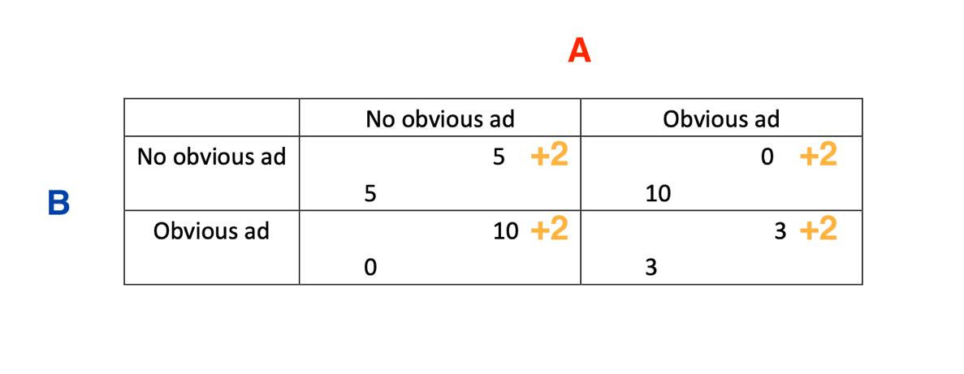
Game model

Slide 10
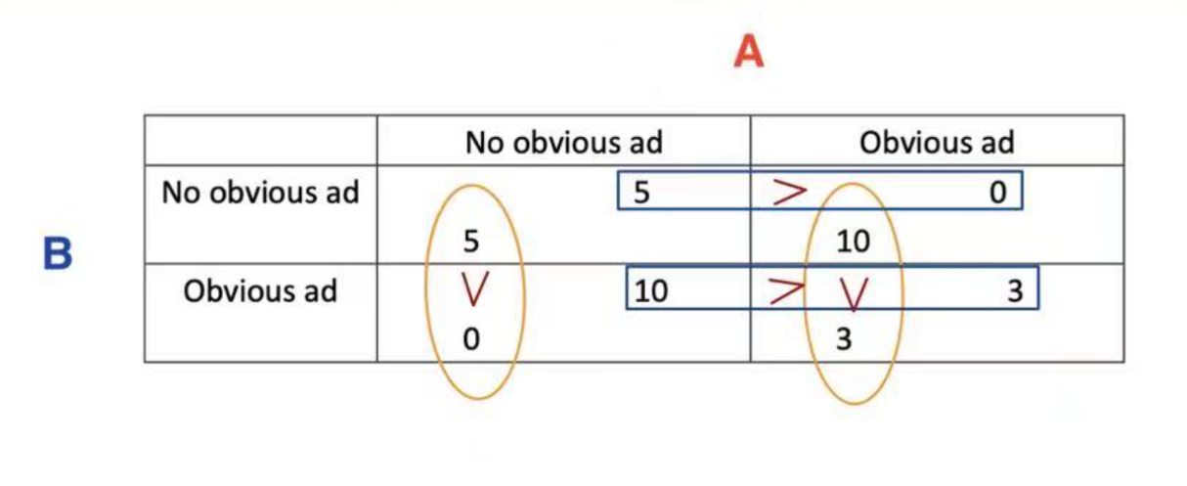

Analysis
Dominant strategy
(No obvious ad, No obvious ad)

Slide 11
Limitations
Only the competition between two SMIs is analyzed in this research.
SMIs analyzed in this research have the same objective conditions.
3. This research is conducted without considering other subjective factors, which may introduce some bias to the study results.

Slide 12
References
Akram, Umair, Muhammad Junaid, Abaid Ullah Zafar, Zhiwen Li, and Mingyue Fan. "Online purchase intention in Chinese social commerce platforms: Being emotional or rational?." Journal of Retailing and Consumer Services 63 (2021): 102669.
Giles, David C. "How do fan and celebrity identities become established on Twitter? A study of ‘social media natives’ and their followers." Celebrity studies 8, no. 3 (2017): 445-460.
Hajli, Nick, Julian Sims, Arash H. Zadeh, and Marie-Odile Richard. "A social commerce investigation of the role of trust in a social networking site on purchase intentions." Journal of Business Research 71 (2017): 133-141.
Jin, Seung-A. Annie, and Joe Phua. "Following celebrities’ tweets about brands: The impact of twitter-based electronic word-of-mouth on consumers’ source credibility perception, buying intention, and social identification with celebrities." Journal of advertising 43, no. 2 (2014): 181-195.
Kunz, Michelle B., Brittany Hackworth, Peggy Osborne, and J. Dustin High. "Fans, friends, and followers: Social media in the retailers’ marketing mix." Journal of Applied Business and Economics 12, no. 3 (2011): 61-68.
Liu, Pu, Mengqi Li, Dong Dai, and Lingyun Guo. “The effects of social commerce environmental characteristics on customers’ purchase intentions: The chain mediating effect of customer-to-customer interaction and customer-perceived value.” Electronic Commerce Research and Applications 48 (2021): 101073.
Rashid, Rao Muhammad, Qurat ul Ain Rashid, and Abdul Hameed Pitafi. "Examining the role of social factors and mooring effects as moderators on consumers’ shopping intentions in social commerce environments." SAGE Open 10, no. 3 (2020): 2158244020952073.
Riaz, Muhammad Usman, Luo Xiao Guang, Maria Zafar, Fakhar Shahzad, Muhammad Shahbaz, and Majid Lateef. "Consumers’ purchase intention and decision-making process through social networking sites: a social commerce construct." Behaviour & Information Technology 40, no. 1 (2021): 99-115.
Yuan, Shupei, and Chen Lou. "How social media influencers foster relationships with followers: The roles of source credibility and fairness in parasocial relationship and product interest." Journal of Interactive Advertising 20, no. 2 (2020): 133-147.

Slide 13
Thank you

